Slide 1

Food: the next global crisis?
Professor Wyn Morgan
School of Economics

Slide 2
Tonight’s Talk
So, what’s the problem?
Prices, price, prices……..
It’s not all economics: Global Food Security at the University of Nottingham

Slide 3

http://www.vam.ac.uk/images/image/42156-popup.html

Slide 4
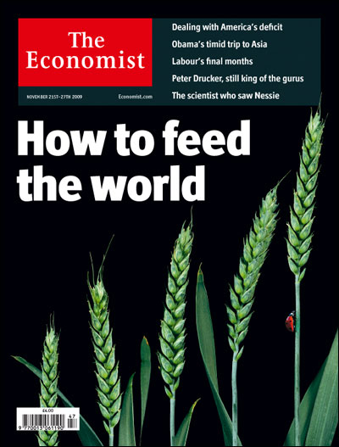

Slide 5
So, what’s the problem?
Global population to reach 9 billion by 2050
Distribution
  1 billion starving; 1 billion overweight/obese
Production
  Supply problems/the right crops?
Concern over Prices
  Food riots and food inflation

Slide 6

http://www.bis.gov.uk/foresight/our-work/projects/current-projects/global-food-and-farming-futures/reports-and-publications

Slide 7
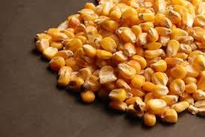
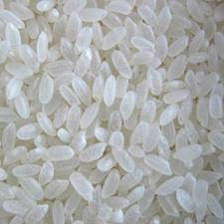
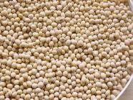

Prices, prices, prices……..
Between 2006 and 2008….
107%
125%
217%
136%

Slide 8

Demand and population growth?
http://blog.nielsen.com/nielsenwire/consumer/down-to-a-science-pinpointing-retail-growth-markets/

Slide 9
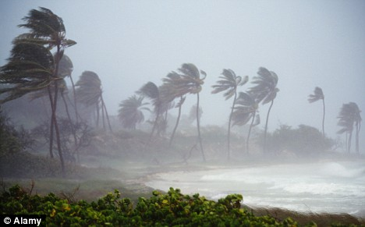
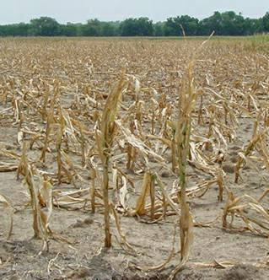
Supply shocks?
http://www.dailymail.co.uk/travel/article-1190884/Holiday-heaven-hell-Storm-hit-Florida-courting-Cuba.html
http://morichesdaily.com/2010/08/food-inflation-growing-problem/

Slide 10
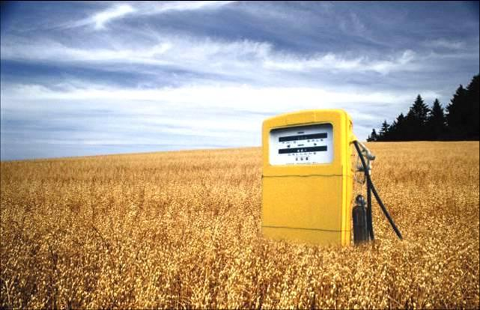
Biofuels?
http://bio-fuel-watch.blogspot.com/

Slide 11

The value of the US Dollar?
http://commons.wikimedia.org/wiki/File:One_US_dollar_note_0127_22.jpg

Slide 12


Interest rates?
http://onefaceinamillion.com/current-mortgage-interest-rates/1076/
http://buyhomesinfo.com/?p=71

Slide 13

The price of oil?
http://www.solarnavigator.net/petroleum.htm

Slide 14
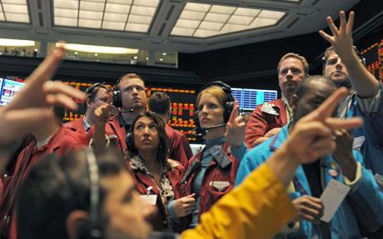
Speculators?
http://www.telegraph.co.uk/finance/newsbysector/banksandfinance/2987827/Market-turmoil-FSA-bans-speculators-from-short-selling.html

Slide 15
It’s Not all Economics…….
Global Food Security - a priority area at the University of Nottingham
Taking an interdisciplinary approach to projects – arts, social sciences, natural sciences, medical sciences etc..
University well positioned to contribute at a research and training level on a global stage

Slide 16
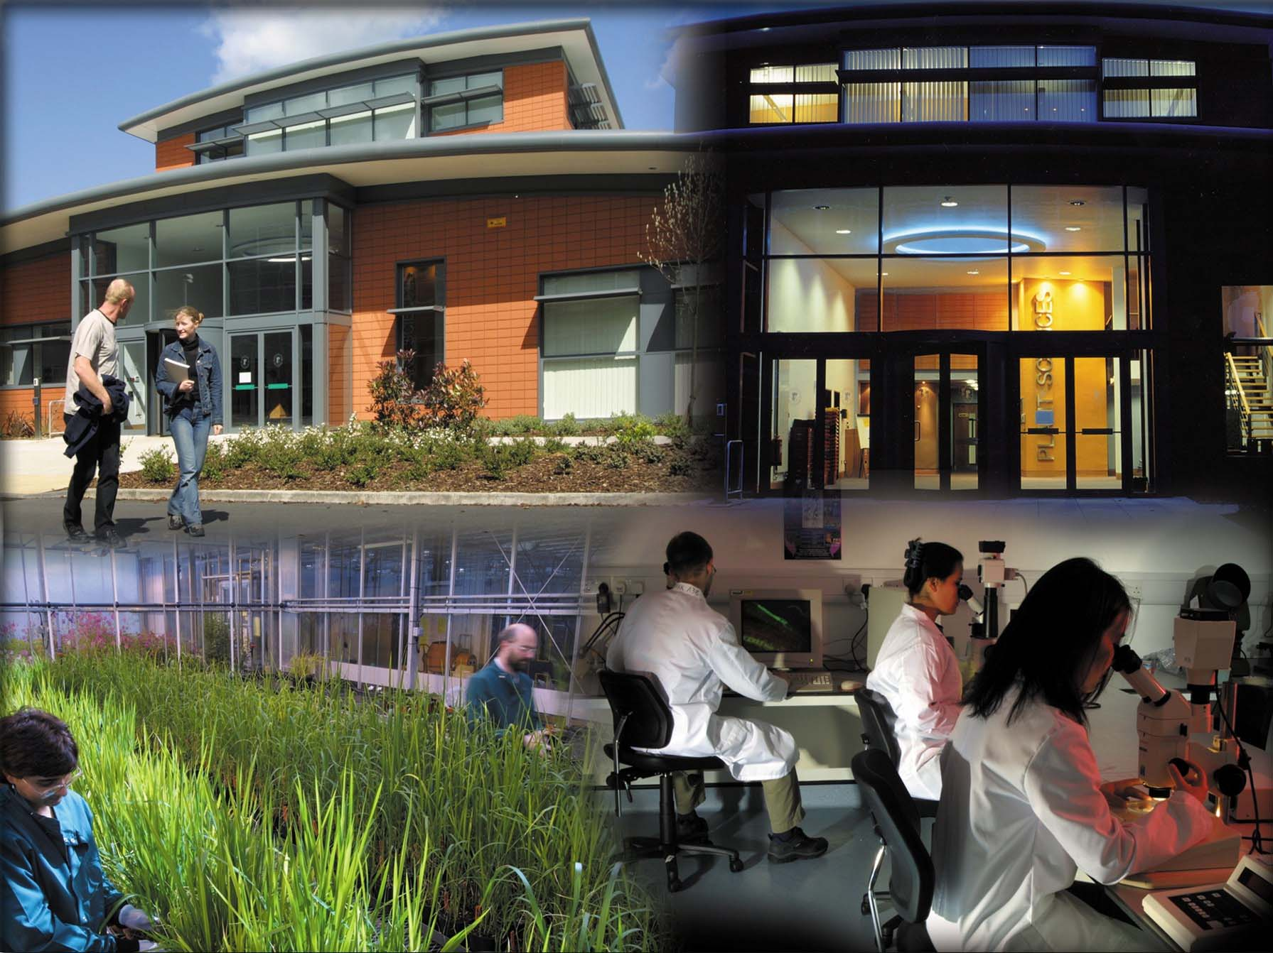
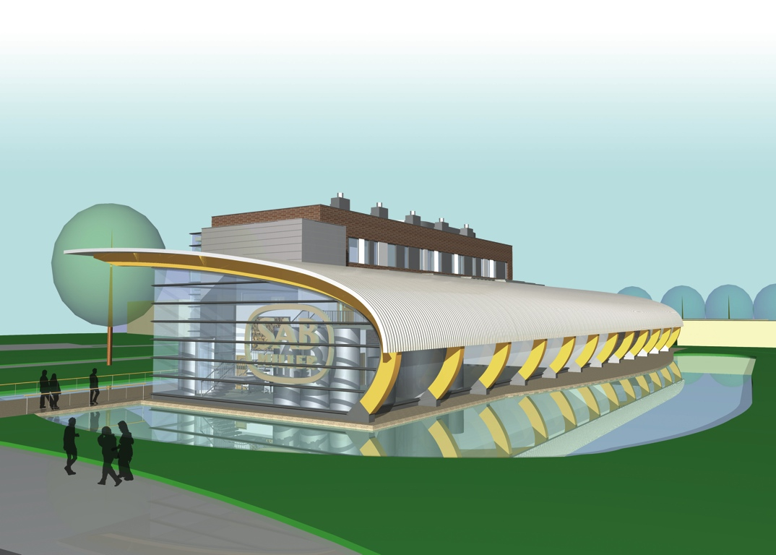
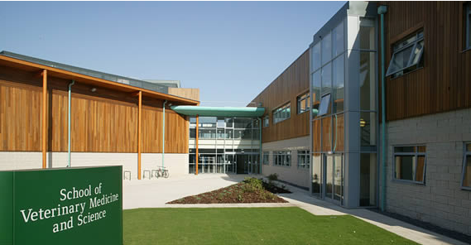

University has invested over £45M in agricultural and food-related research over the last 10 years
Food Sciences (1999 & 2008)
Plant Sciences (2002)
Robotic dairy unit (2005)
Vet School (2006)
Bioenergy building (2010)
GFS glasshouse complex (2010)

Slide 17
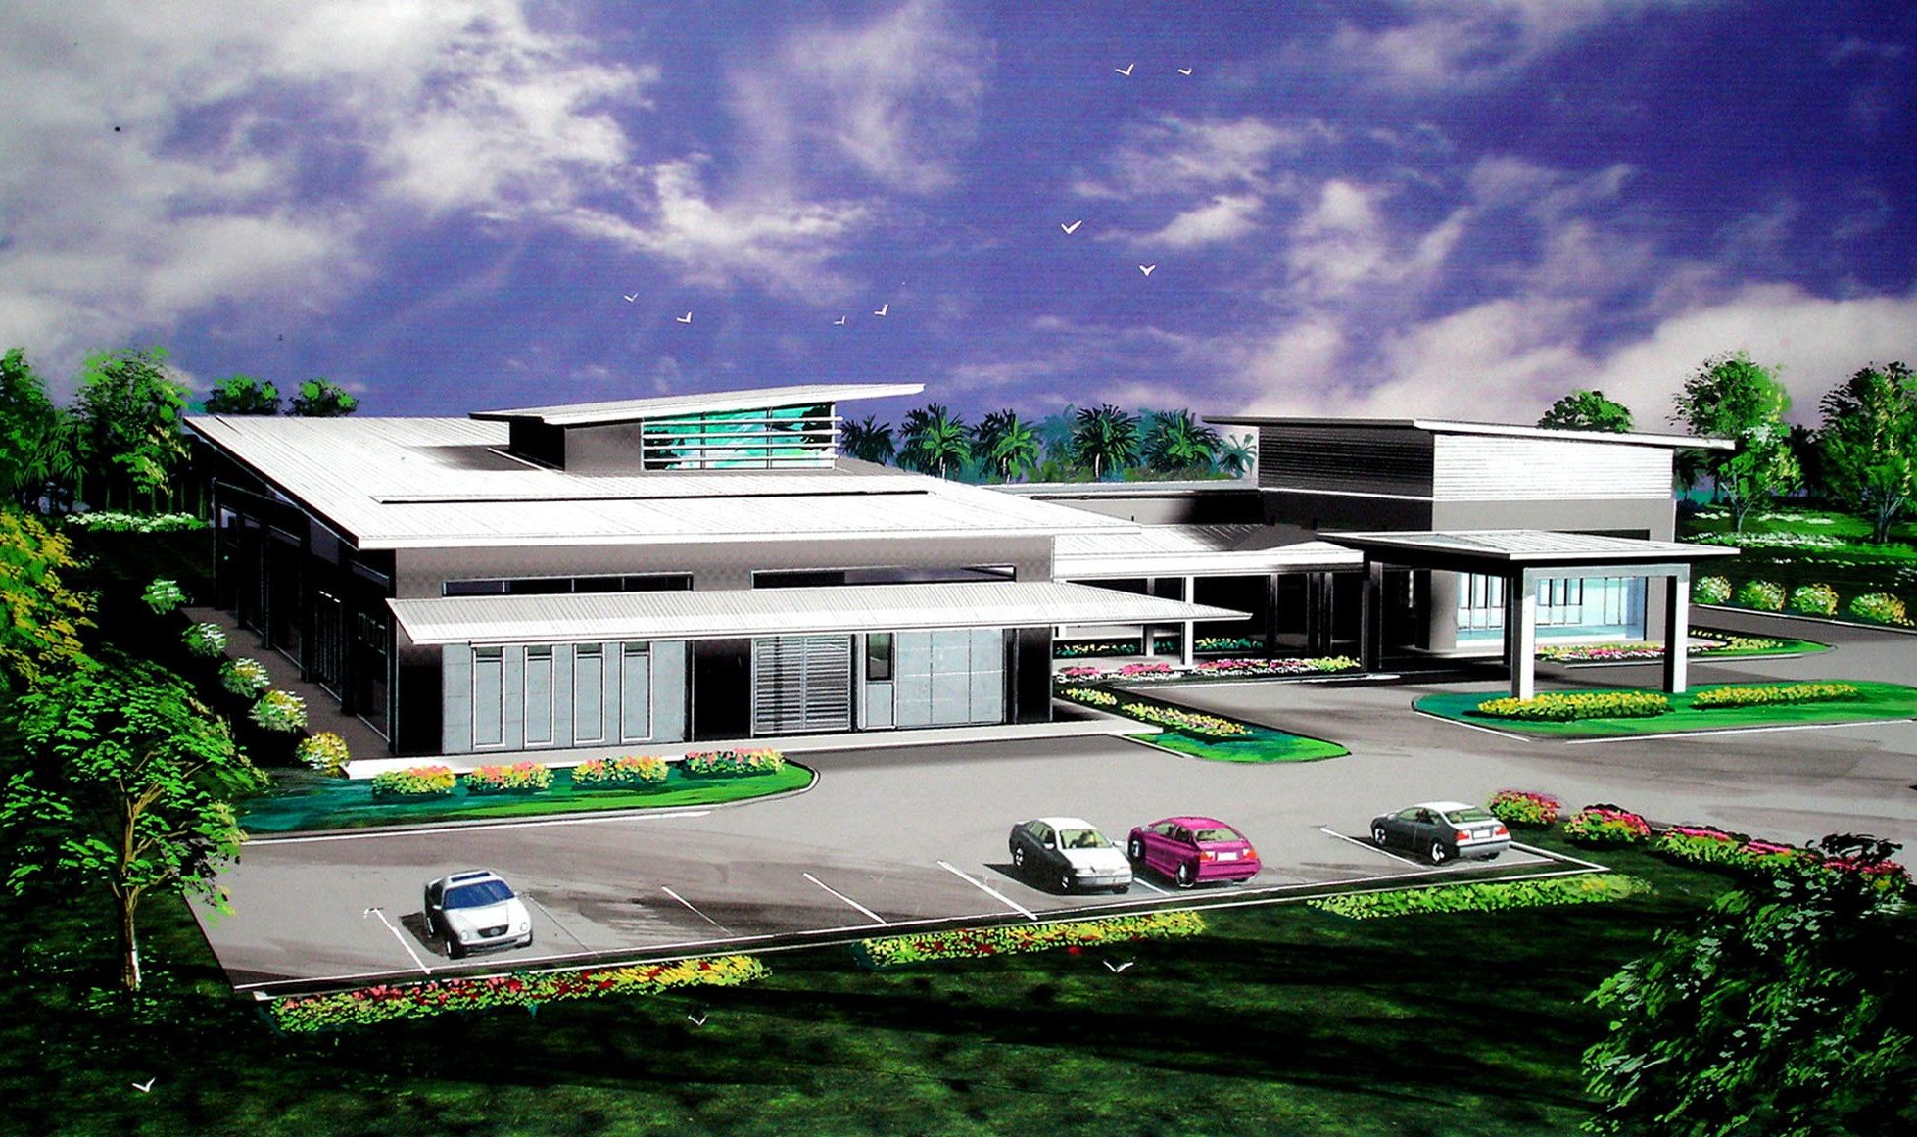
AAR/UNMC Plant Biotechnology Research Centre
Opened September 2009

Slide 18

‘Crops for the Future’ evolved in 2008 from a union of the International Centre for Underutilised Crops (ICUC) and the Global Facilitation Unit for Underutilized Species (GFU).

Slide 19
Food for thought…..
Financial crisis affects us all but can be dealt with by policy makers and…. dare I say…
even economists!
Food crisis affects us all more fundamentally
Answers can lie in inter-disciplinary approaches to provide new ideas
University of Nottingham is leading the way in providing global answers for a global problem

